Slide 1
Title: Noise estimation in thermocouples
Subtitle: Precision EMF Monitoring and Uncertainty Quantification

Slide 2
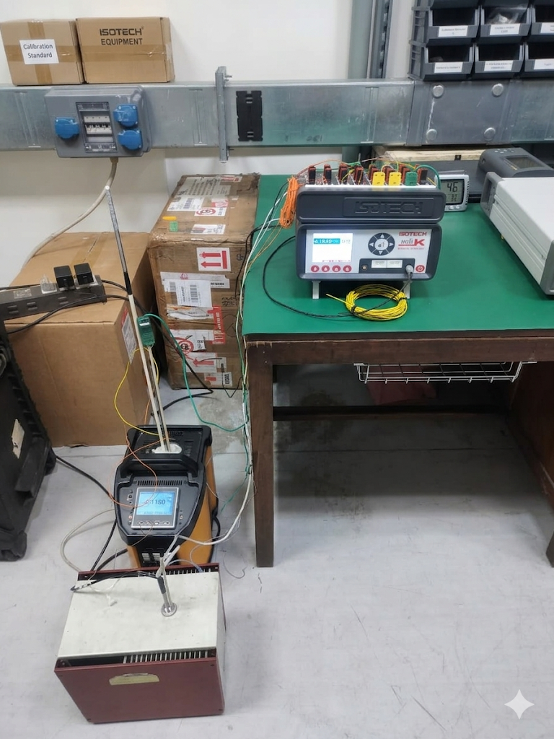
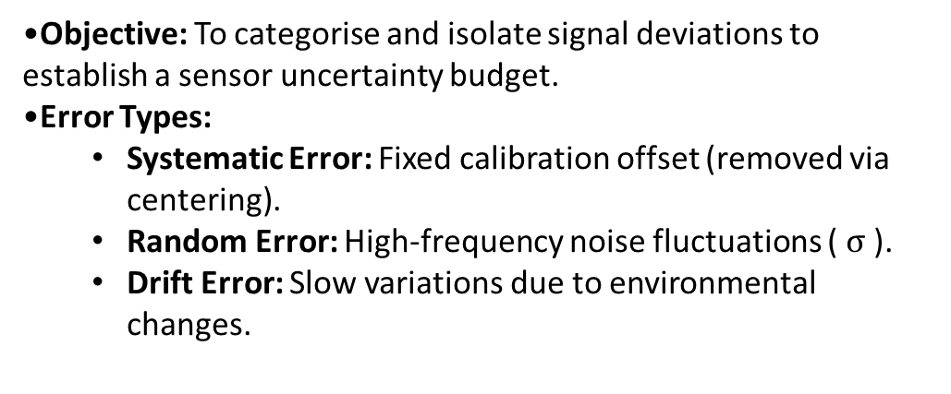
Metrological Framework (ISO GUM)
Objective: To categorise and isolate signal deviations to establish a sensor uncertainty budget.
Error Types:
  Systematic Error: Fixed calibration offset (removed via centering).
  Random Error: High-frequency noise fluctuations ( $σ$ ).
  Drift Error: Slow variations due to environmental changes.
Experimental Setup
Sensor Selection: Pooled resources of Type S (Platinum Rhodium – 10% / Platinum), Type K (Nickel – Chromium / Nickel – Alumel), and Type N (Nicrosil/Nisil) (Quantity: 2).
Configuration: Measurement performed without a Cold Junction to analyse raw EMF sensitivity.
Environmental Control:
  Temperature: 24 ± 2°C
  Humidity: 50 ± 5 % RH
Goal: Identify noise signatures to refine the measurement model equation.

Slide 3
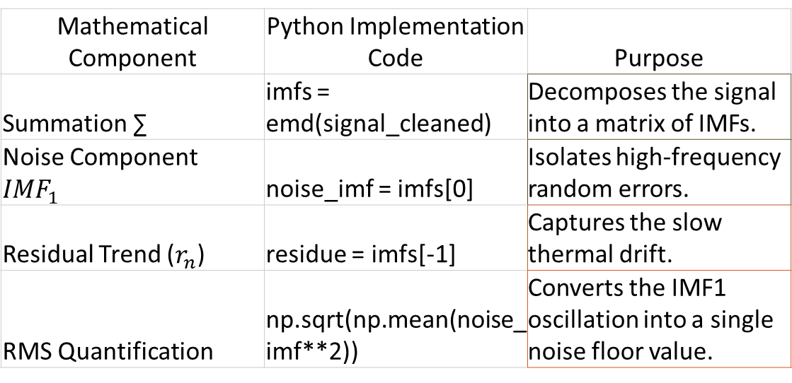
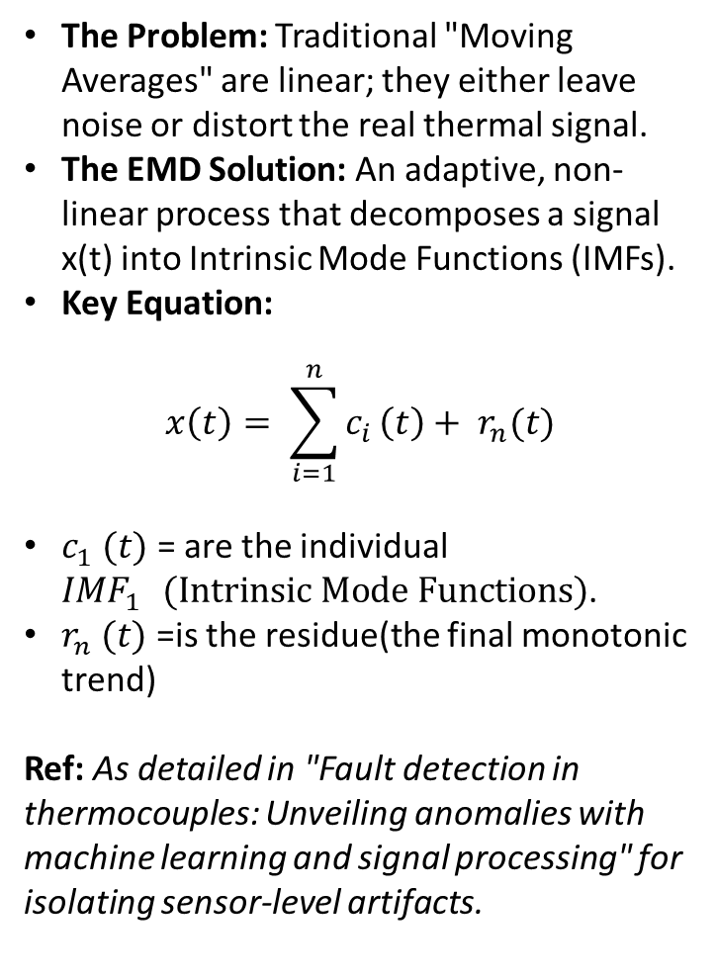
Why use this specific equation?
Methodology – Why Empirical Mode Decomposition (EMD)?
Non-Stationarity: Thermocouple data in a lab environment is often non-stationary (the mean and variance change over time). EMD does not assume a fixed frequency, unlike Fourier Transforms.
Adaptive Filtering: Unlike a "Moving Average" which uses a fixed window, EMD "sifts" the signal based on its own local maxima and minima.
The Problem: Traditional "Moving Averages" are linear; they either leave noise or distort the real thermal signal.
The EMD Solution: An adaptive, non-linear process that decomposes a signal x(t) into Intrinsic Mode Functions (IMFs).
Key Equation:
$$x\left(t\right)= \sum_{i=1}^{n}{c_{i}}\left(t\right)+ r_{n}(t)$$
$c_{1} (t)$ = are the individual ${IMF}_{1 } (Intrinsic Mode Functions)$.
$r_{n} (t)$ =is the residue(the final monotonic trend)
Ref: As detailed in "Fault detection in thermocouples: Unveiling anomalies with machine learning and signal processing" for isolating sensor-level artifacts.
Mathematical Component | Python Implementation Code | Purpose
Summation ∑ | imfs = emd(signal_cleaned) | Decomposes the signal into a matrix of IMFs.
Noise Component ${IMF}_{1 }$ | noise_imf = imfs[0] | Isolates high-frequency random errors.
Residual Trend ($r_{n}$) | residue = imfs[-1] | Captures the slow thermal drift.
RMS Quantification | np.sqrt(np.mean(noise_imf**2)) | Converts the IMF1​ oscillation into a single noise floor value.

Slide 4
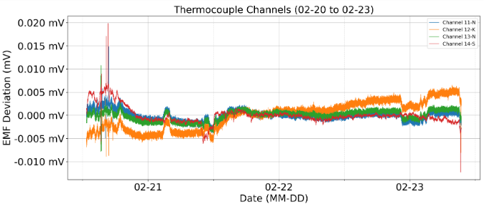
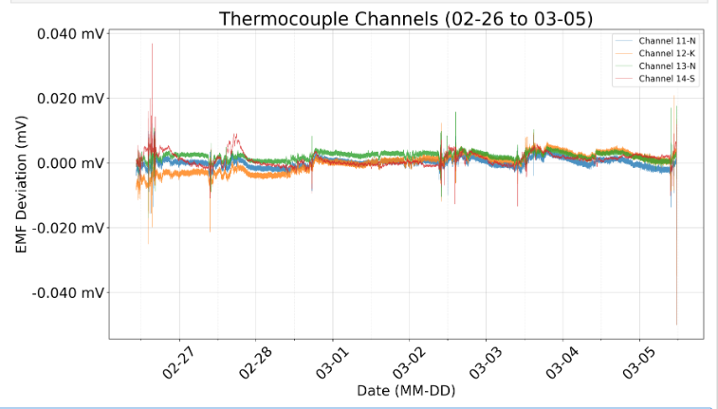
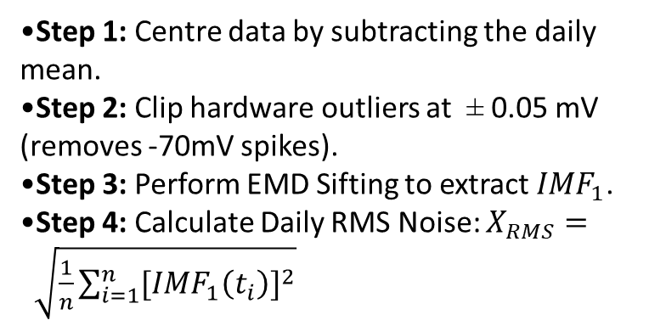
Implementation – Processing Pipeline
Step 1: Centre data by subtracting the daily mean.
Step 2: Clip hardware outliers at ± 0.05 mV (removes -70mV spikes).
Step 3: Perform EMD Sifting to extract ${IMF}_{1}$.
Step 4: Calculate Daily RMS Noise: $X_{RMS}= \sqrt{\frac{1}{n}\sum_{i=1}^{n}{{[{IMF}_{1}\left(t_{i}\right)]}^{2}}}$
Purpose: It gives you a single number that represents the stability of the sensor for the entire day.
Use Case: This is what you put in your summary table to show that the sensor's noise floor is roughly $0.0003 \text{ mV}$.

Slide 5
Daily RMS Noise Trend in mV and Temperature Trend (°C)
Metric: Tracking the "Noise Floor" across four channels.
Summary Table:
Date | Channel 11-N RMS (mV) | Channel 12-K RMS (mV) | Channel 13-N RMS (mV) | Channel 14-S RMS (mV) | Applying with Sensitivity coefficient
 |  |  |  |  | Channel 11-N RMS (°C) (0.036 mv/°C) | Channel 12-K RMS (°C) (0.041 mv/°C) | Channel 13-N RMS (°C) (0.036 mv/°C) | Channel 14-S RMS (°C) (0.009 mv/°C)
26-02-2026 | 0.00046 | 0.00044 | 0.00037 | 0.00052 | 0.012833 | 0.010659 | 0.010306 | 0.05756
27-02-2026 | 0.00024 | 0.00026 | 0.0002 | 9.3E-05 | 0.006611 | 0.006244 | 0.005583 | 0.01033
28-02-2026 | 0.00023 | 0.00023 | 0.00019 | 0.00011 | 0.006389 | 0.005683 | 0.005278 | 0.01256
01-03-2026 | 0.00023 | 0.00024 | 0.00018 | 0.00005 | 0.00625 | 0.005732 | 0.005083 | 0.00556
02-03-2026 | 0.00033 | 0.00031 | 0.00027 | 0.00024 | 0.009111 | 0.007537 | 0.007472 | 0.02689
03-03-2026 | 0.00025 | 0.00025 | 0.0002 | 0.00011 | 0.006972 | 0.006195 | 0.005444 | 0.01222
04-03-2026 | 0.00023 | 0.00024 | 0.00019 | 4.8E-05 | 0.006306 | 0.005805 | 0.005194 | 0.00533
05-03-2026 | 0.00033 | 0.00036 | 0.00054 | 0.00077 | 0.009278 | 0.008829 | 0.015056 | 0.08511

Slide 6
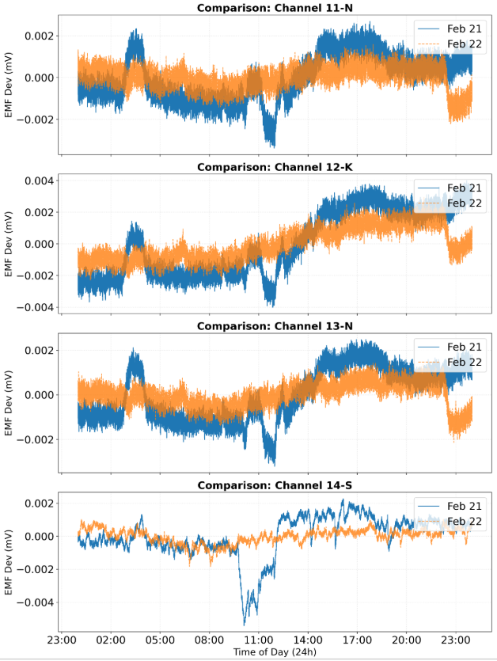
Comparative Stability (Working Day vs. Holiday)
Analysis: Overlapped Feb 21 (Working Day) and Feb 22 (Holiday) to detect patterned vs. random errors.
Observation: High correlation between consecutive days confirms that the observed drift is a Systematic Error linked to the lab's 24-hour ambient temperature cycle.

Slide 7
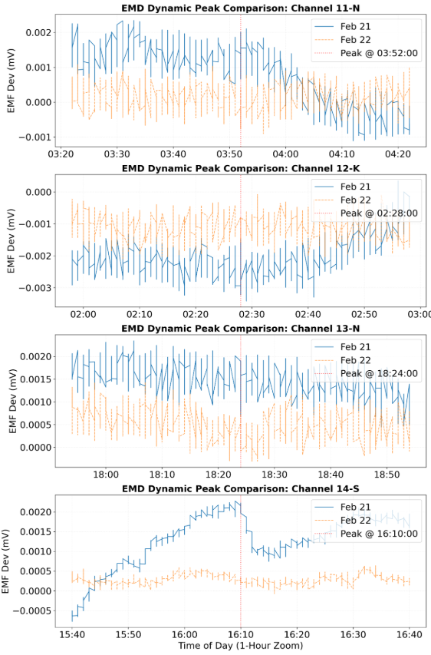
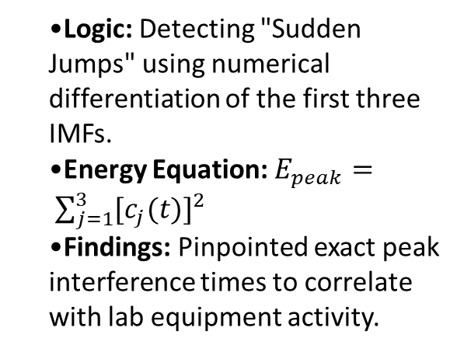
Dynamic Peak Energy & Transient Detection
Logic: Detecting "Sudden Jumps" using numerical differentiation of the first three IMFs.
Energy Equation: $E_{peak}= \sum_{j=1}^{3}{{[c_{j}(t)]}^{2}}$
Findings: Pinpointed exact peak interference times to correlate with lab equipment activity.
Purpose: It gives you a time-series that shows when interference happened. You are looking for the maximum value in that series ($argmax$).
Use Case: This is what you use to draw the vertical red line on your graph to tell your Sir: "Look, at exactly 03:52:00, the energy spiked."

Slide 8
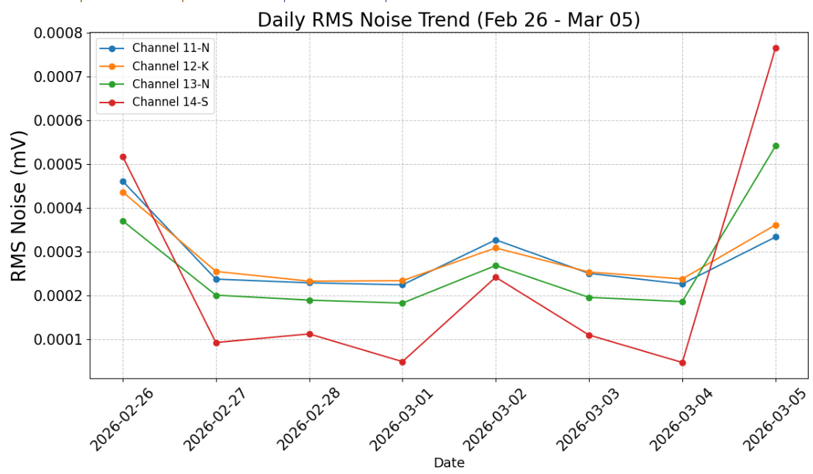
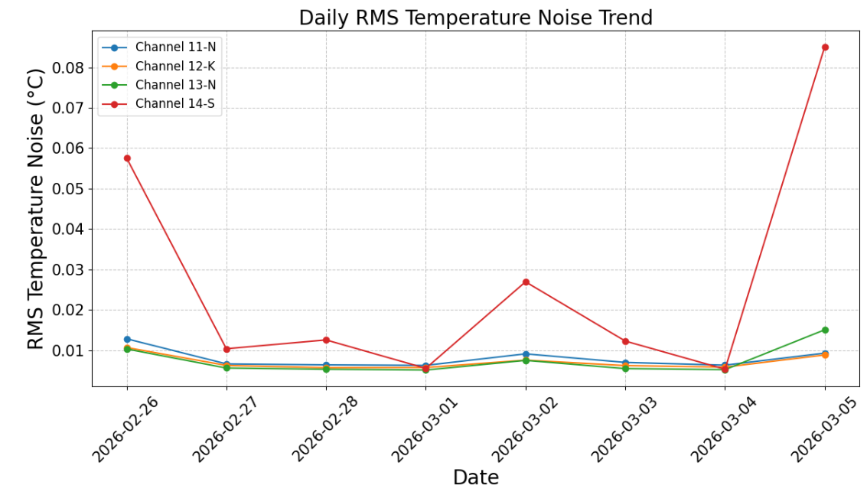
Daily RMS Noise Trend in mV
Daily RMS Temperature Trend in (°C)

